Slide 1
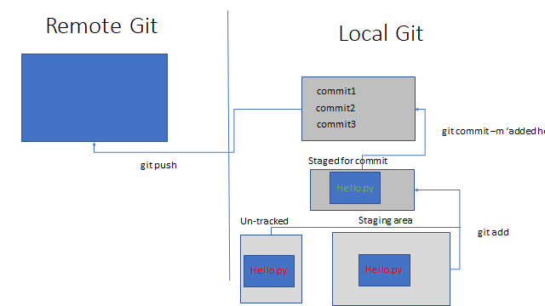

Slide 2
Remote Git
Local Git
commit1
git pull
commit3
commit2
Staged for commit
Hello.py
Staging area
Un-tracked
Hello.py
git restore --staged
Hello.py
rm
git restore

